Slide 1

Engineering Project Portfolio
Louis Cardot
Fall 2021

Slide 2

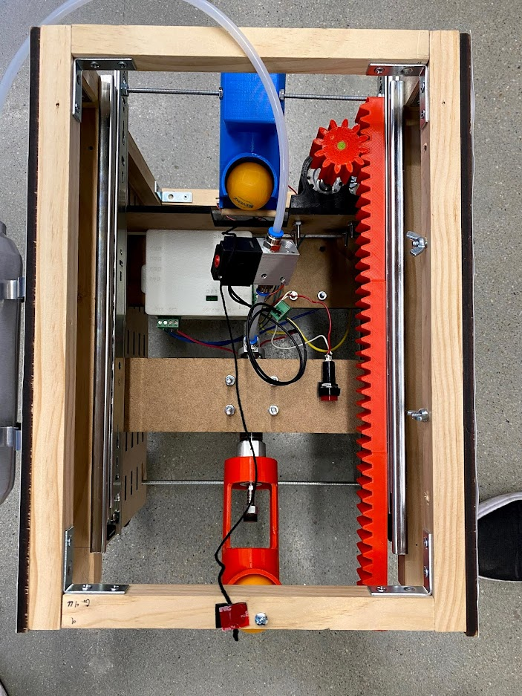
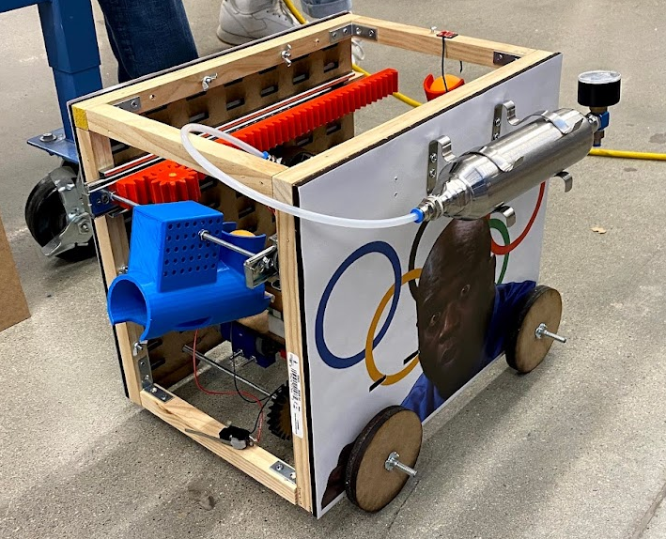
ME 2110 Robot (Class Team Final Project)
Back
Barrel
Design and fabricate a robot to score points through performance based tasks
Wrote technical reports and presentations covering robot designs and engineering design process
Responsibilities:
Arduino programming for motor movements, timing of pneumatic firing, and robot subsystem logic
Design and modeling of front and back 3D printed barrels
Basic wood shop and laser cutting skills (frame, part supports, subsystem prototypes)
Front
Barrel

Slide 3
Implicit Function Python Slicing Algorithm Research
Main goals:
Develop a python slicing algorithm to efficiently generate printable GCODE from any given implicit function.
Implement rudimentary 3D slicing features such as supports, infill, thickness, etc.
Real-world uses:
Allows for skipping the STL phase when 3D printing, which is known for creating surface inaccuracies due to the 3D mesh created.
Allows for generating complex, but repeatable trigonometric geometries, which is historically difficult for 3D modeling software.

Slide 4
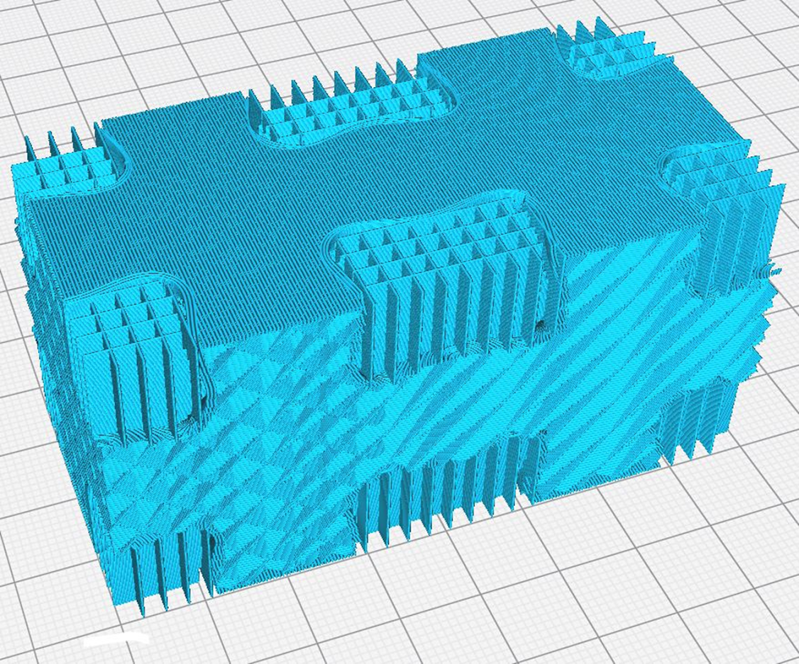
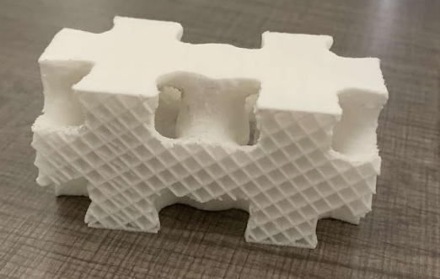
Implicit Function Python Slicing Algorithm Research (Cont.)
Supports
Responsibilities:
Writing code for:
Inner walls
Infill (grid, cubic, concentric)
Supports
Top/bottom thickness
Bed adhesions (skirt, brim)
Filament extrusion calculation
Algorithm xyz point to GCODE conversion
Weekly updates to partner and research professor
Presenting semester research progress to student/professor seminar
Algorithm GCODE generation (top right) and final 3D print (bottom right)
Top/Bottom Thickness
Inner Walls
Infill (Cubic)

Slide 5
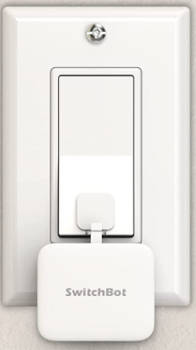
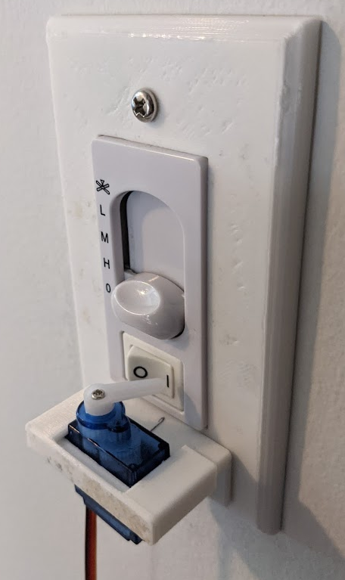
SwitchBot Personal Project
INSPIRATION
EXECUTION
Mini robot to remotely turn light switch on and off
Servo motor remote control via radio module communication
Custom 3D printed light switch servo mount
Arduino and basic protoboard electronics

Slide 6
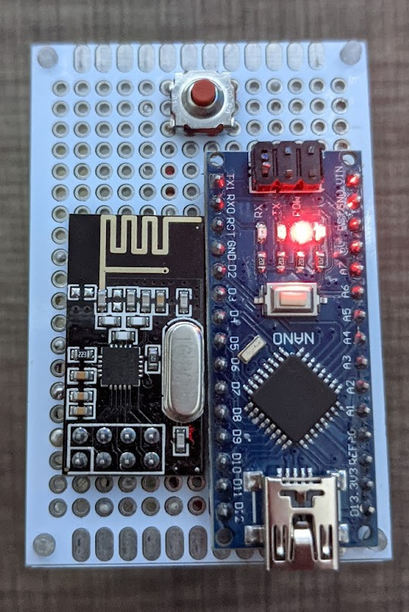
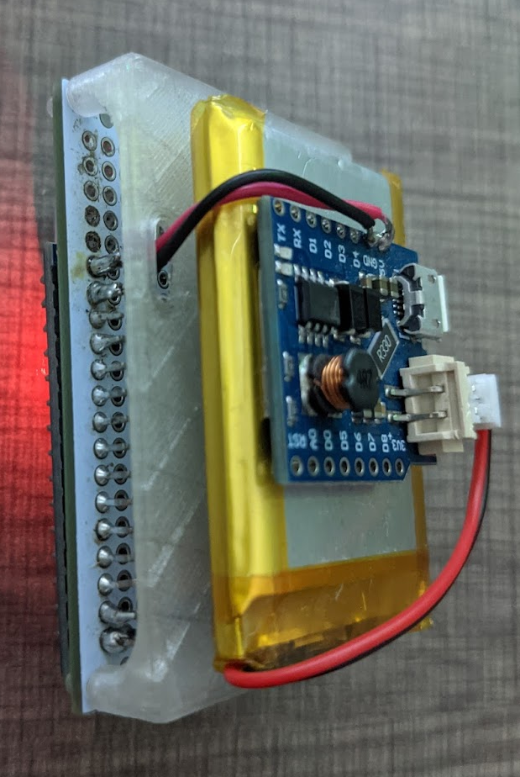
SwitchBot Personal Project (Cont.)
REMOTE
Button Control
Custom Protoboard
LIPO Battery
Radio Module
Battery Shield
Arduino Nano

Slide 7
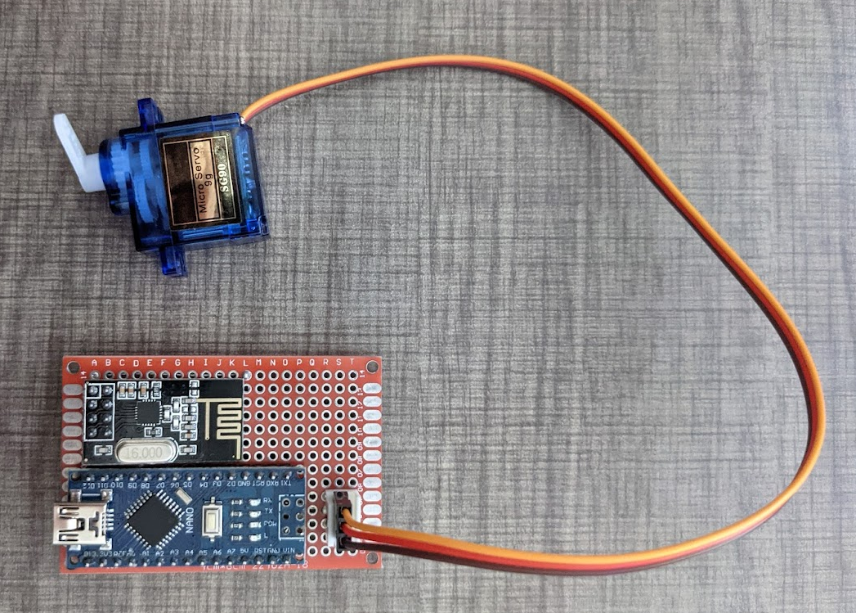
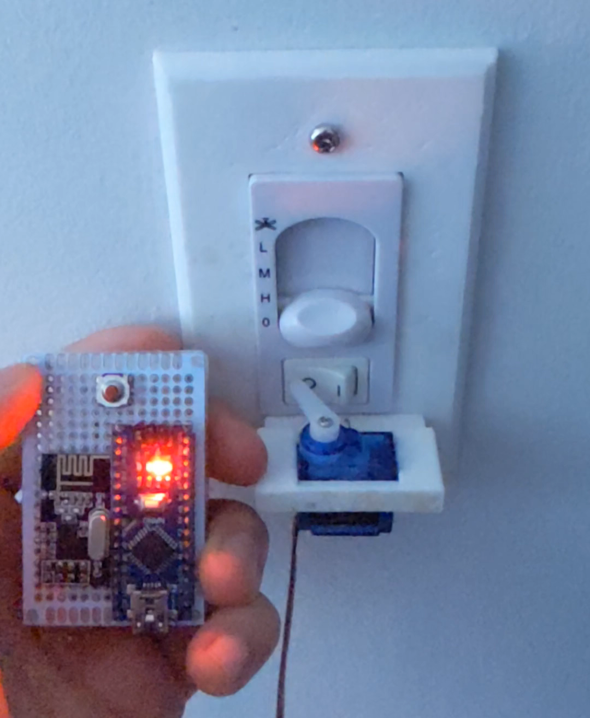
SwitchBot Personal Project (Cont.)
RECEIVER
VIDEO DEMONSTRATION
Servo Motor
Radio Module
Arduino Nano

Slide 8
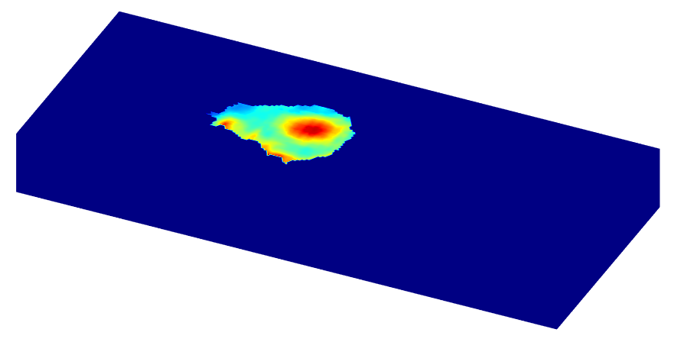
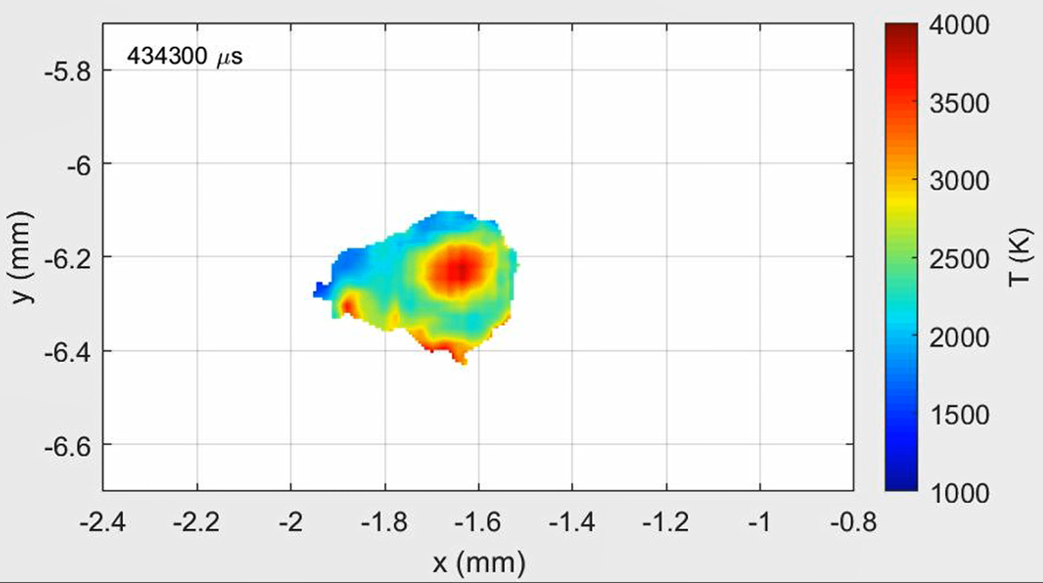
MATLAB Image Processing Research
Tasked with using MATLAB to generate a 3D mesh from a given temperature map of a laser as it travels across a 3D print bed.
Below is one frame (left) of the video that was used to generate this mesh (right).

Slide 9
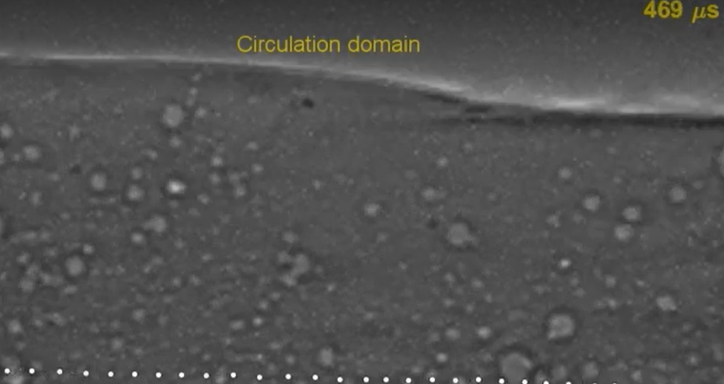
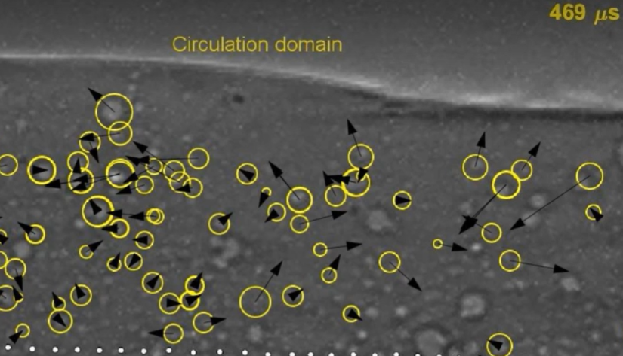
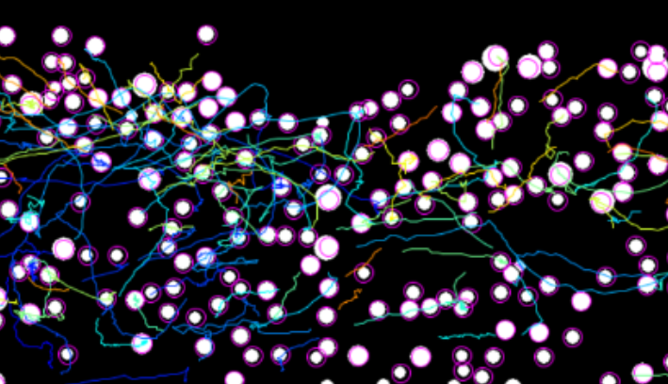
MATLAB Image Processing Research (Cont.)
Use MATLAB and ImageJ Fiji to track the direction and speed of air bubbles through liquid metal caused by the 3D metal printing process.
Original video frame (top right), MATLAB output (bottom left), and ImageJ output (bottom right).

